Slide 1



E-commerce sales track
View in Power BI
Last data refresh:
11/12/2020

Slide 2
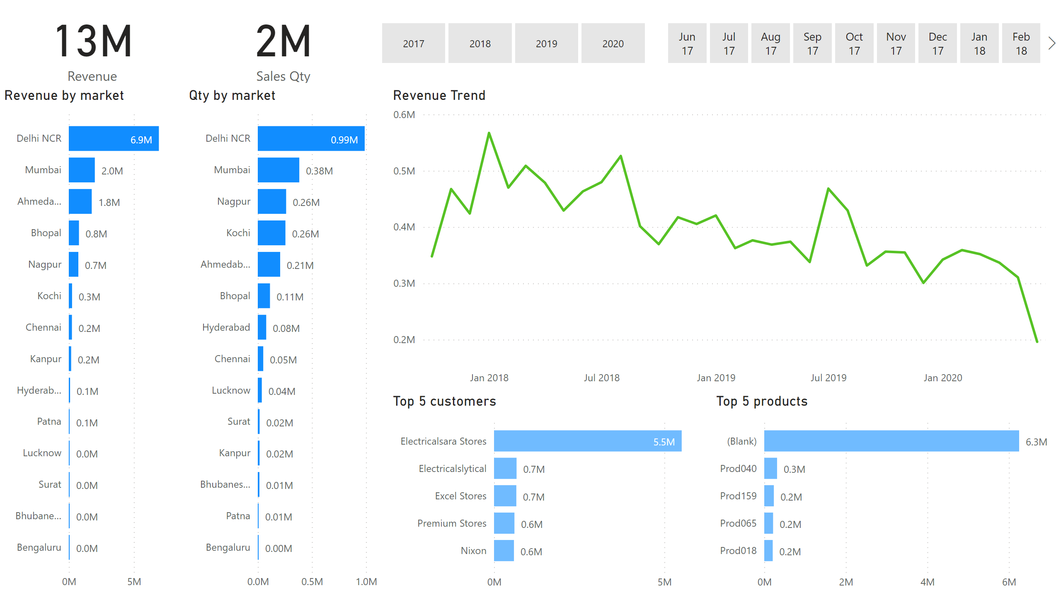
Page 1
Notes:
card
No alt text provided
card
No alt text provided
Revenue by market
No alt text provided
Qty by market
No alt text provided
slicer
No alt text provided
slicer
No alt text provided
Top 5 customers
No alt text provided
Top 5 products
No alt text provided
Revenue Trend
No alt text provided

Slide 3
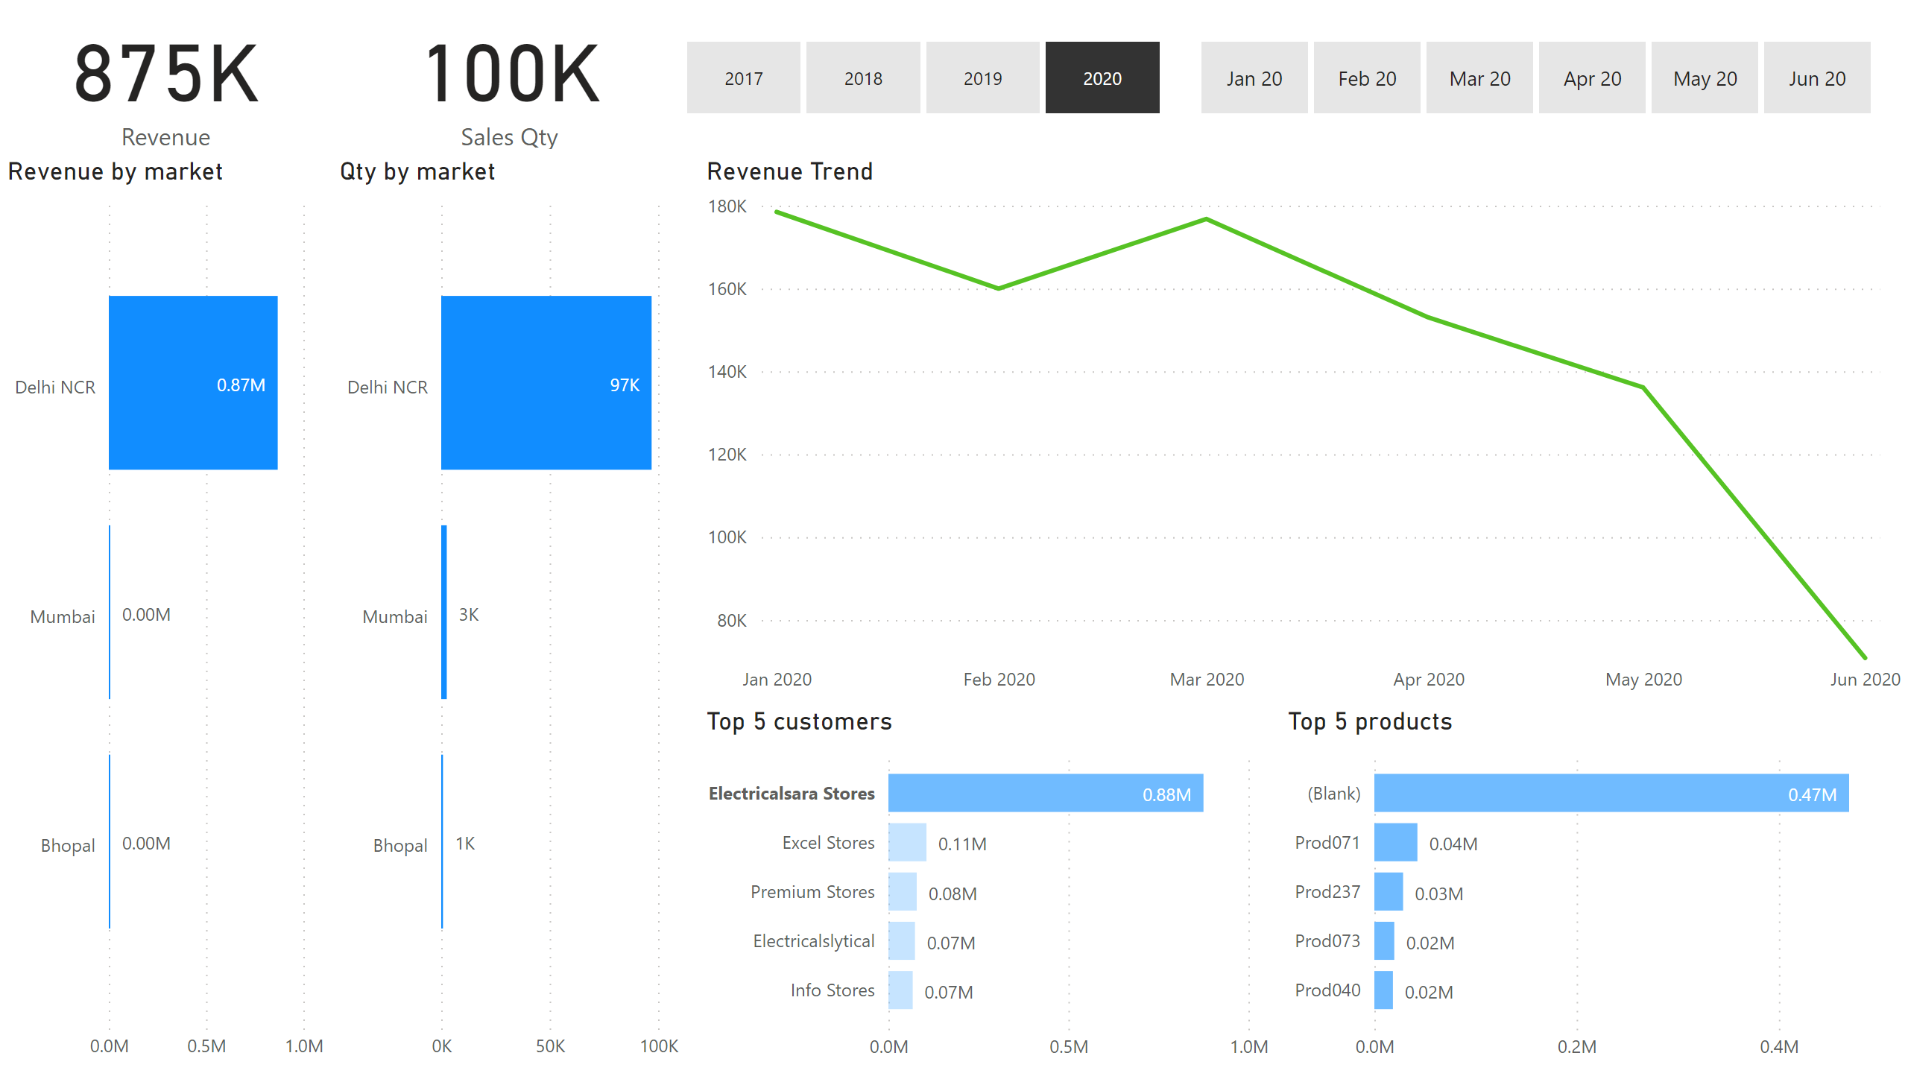
Page 1
Notes:
card
No alt text provided
card
No alt text provided
Revenue by market
No alt text provided
Qty by market
No alt text provided
slicer
No alt text provided
slicer
No alt text provided
Top 5 customers
No alt text provided
Top 5 products
No alt text provided
Revenue Trend
No alt text provided

Slide 4
